Slide 1

Geometry
Unit 7, Lesson 4 Trigonometric Ratios on the Coordinate Plane Volume 1, pg. 387

Slide 2


Benchmarks
MA.912.T.1.1
Define trigonometric ratios for acute angles in right triangles.
MA.912.T.1.2
Solve mathematical and real-world problems involving right triangles using trigonometric ratios and the Pythagorean Theorem.
volume 1, pg. 387

Slide 3
Integrated Mathematical Thinking and Reasoning Standards
MA.K12.MTR.1.1 Actively participate in effortful learning both individually and collectively.
MA.K12.MTR.2.1 Demonstrate understanding by representing problems in multiple ways.
MA.K12.MTR.4.1 Engage in discussions that reflect on the mathematical thinking of self and others.
MA.K12.MTR.5.1 Use patterns and structure to help understand and connect mathematical concepts.
volume 1, pg. 387

Slide 4

Learning Target
I can determine trigonometric ratios using the coordinate plane.
volume 1, pg. 387

Slide 5

Warm-Up
volume 1, pg. 388

Slide 6
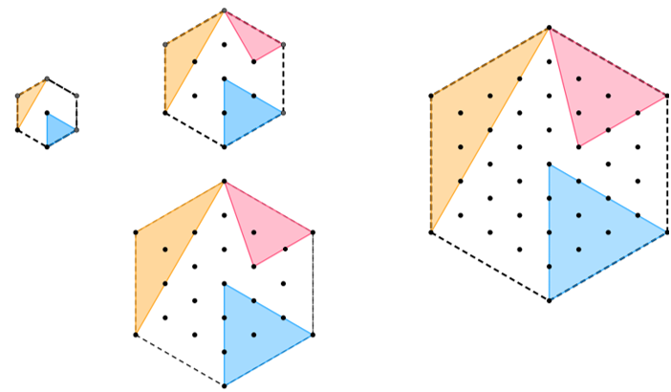
7.4.1 Warm-Up: Patterns
Four hexagons are shown.
volume 1, pg. 388

Slide 7
Describe the pattern of each triangle.
Triangle | Pattern Description
Yellow
Red
Blue
volume 1, pg. 388

Slide 8

Collaboration
volume 1, pg. 388

Slide 9

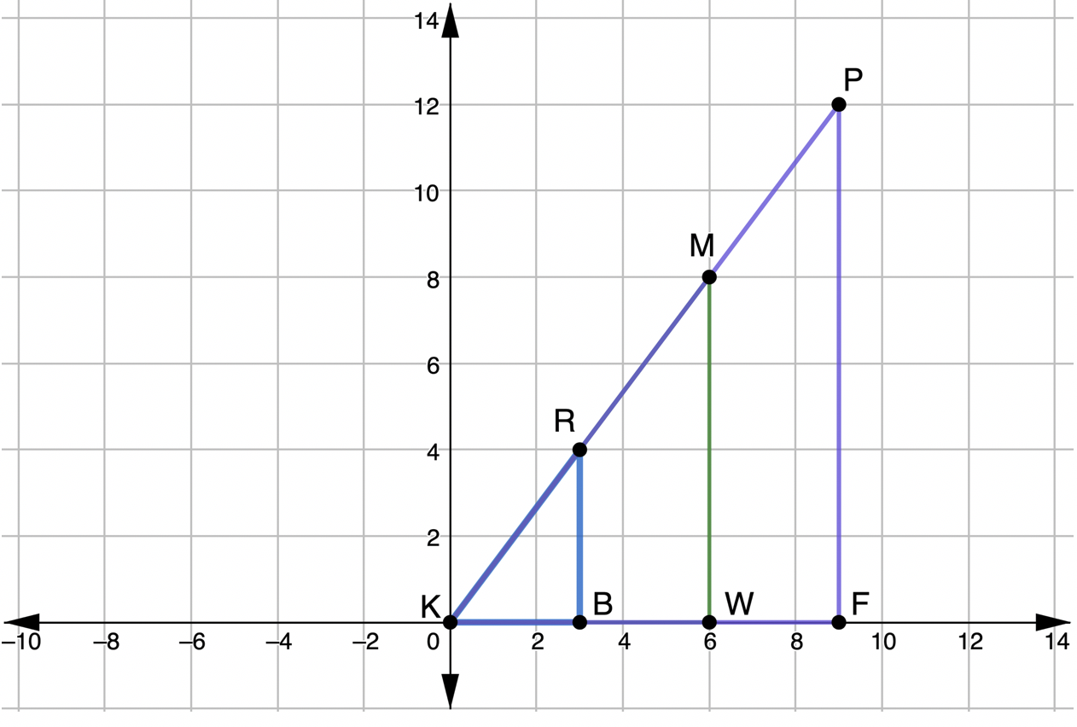
7.4.2 Collaboration: Defining Trigonometric Ratios
Three right triangles are shown on the coordinate grid.
volume 1, pg. 388

Slide 10
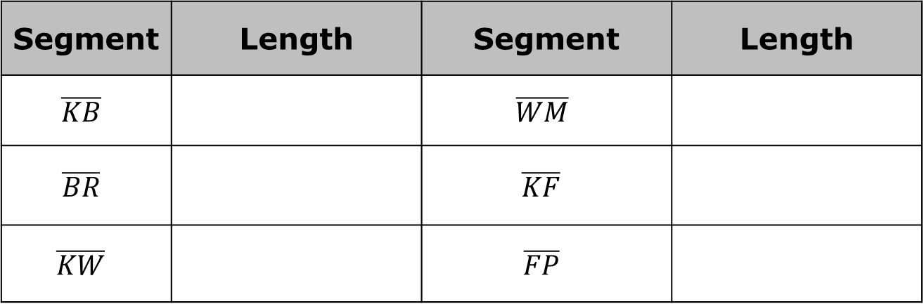
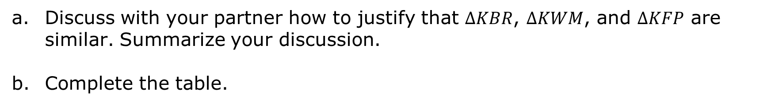
Discuss with your partner how to justify that $∆KBR$, $∆KWM$, and $∆KFP$ are similar. Summarize your discussion.
Complete the table.
Segment | Length | Segment | Length
$$\overline{KB}$$ |  | $$\overline{WM}$$
$$\overline{BR}$$ |  | $$\overline{KF}$$
$$\overline{KW}$$ |  | $$\overline{FP}$$
volume 1, pg. 388

Slide 11
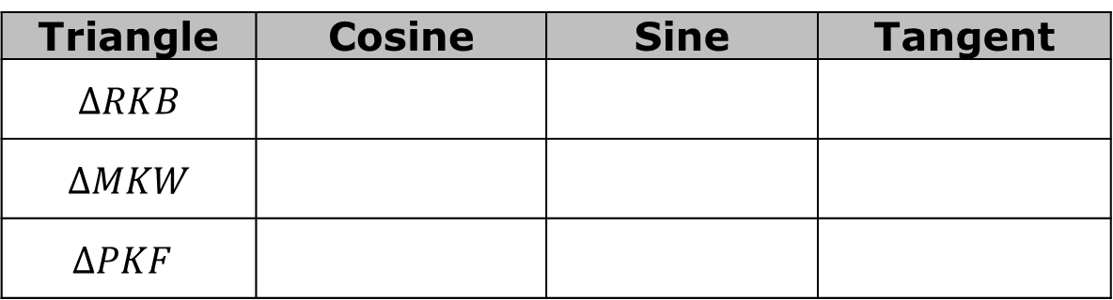
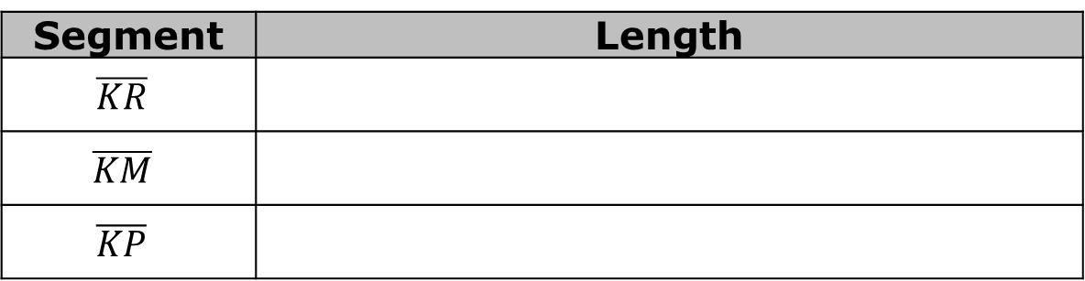

Use the lengths from the table to determine each. Show your work.
Using $∠K$ as the reference angle, find the three ratios for each triangle.
Segment | Length
$$\overline{KR}$$
$$\overline{KM}$$
$$\overline{KP}$$
Triangle | Cosine | Sine | Tangent
$$∆RKB$$
$$∆MKW$$
$$∆PKF$$
volume 1, pg. 389

Slide 12
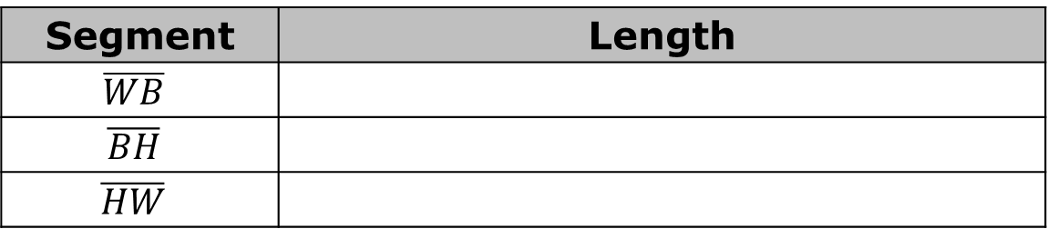
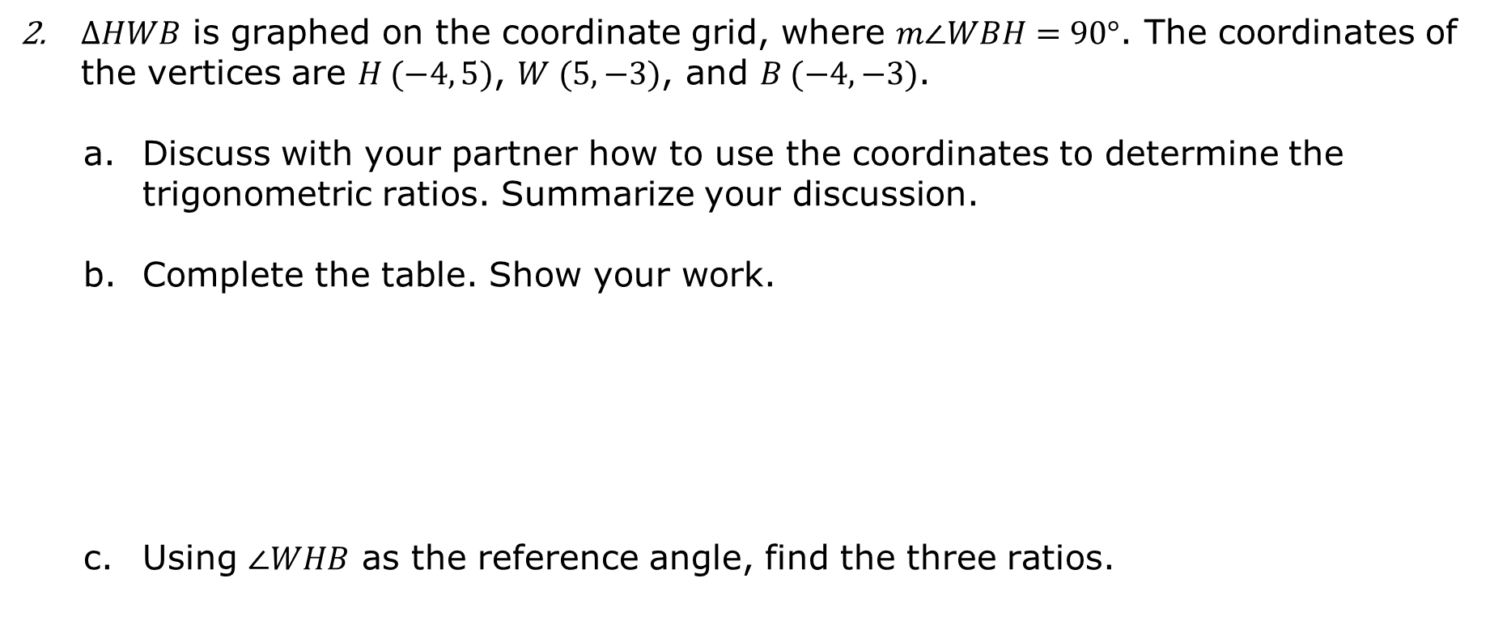
$∆HWB$ is graphed on the coordinate grid, where $m∠WBH=90°$. The coordinates of the vertices are $H (−4, 5)$, $W (5,−3)$, and $B (−4, −3)$.
Discuss with your partner how to use the coordinates to determine the trigonometric ratios. Summarize your discussion.
Complete the table. Show your work.
Using $∠WHB$ as the reference angle, find the three ratios.
Segment | Length
$$\overline{WB}$$
$$\overline{BH}$$
$$\overline{HW}$$
Cosine | Sine | Tangent
volume 1, pg. 389

Slide 13

Guided Instruction
volume 1, pg. 390

Slide 14
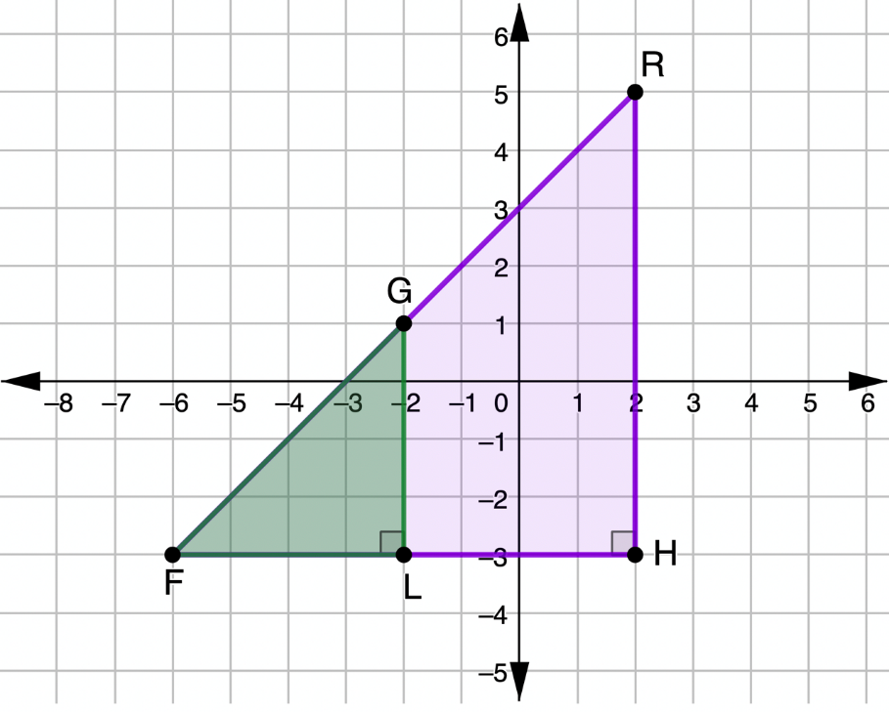
7.4.3 Guided Instruction: Using Trigonometric Ratios
$∆FLG$ and $∆FHR$ shown on the coordinate grid are isosceles right triangles.
volume 1, pg. 390

Slide 15
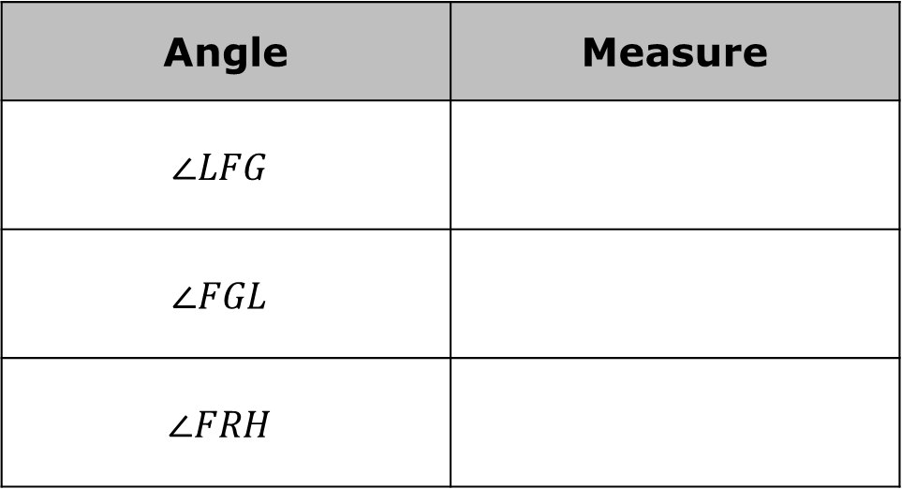
Determine the measure of each angle.
Angle | Measure
$$∠LFG$$
$$∠FGL$$
$$∠FRH$$
volume 1, pg. 390

Slide 16
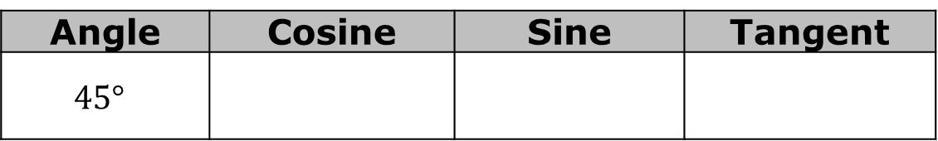
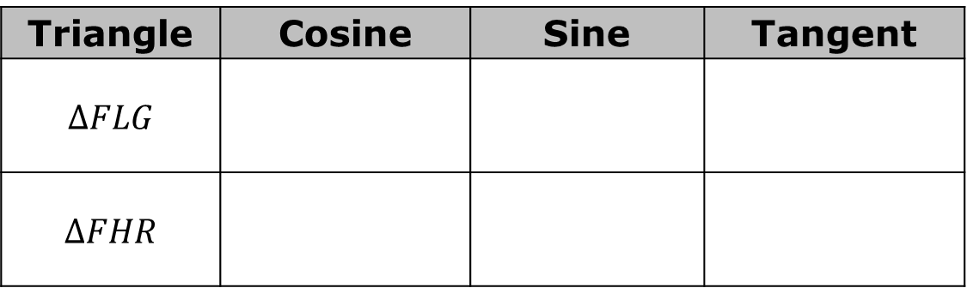

Using $∠F$ as the reference angle, find the three ratios for each triangle.
Use your calculator to find each. Round to the nearest thousandth, if necessary.
How are the ratios you found using $∠F$ as the reference angle related to the values you found for the ratios of a $45°$ angle?
Triangle | Cosine | Sine | Tangent
$$∆FLG$$
$$∆FHR$$
Angle | Cosine | Sine | Tangent
$$45°$$
volume 1, pg. 390

Slide 17
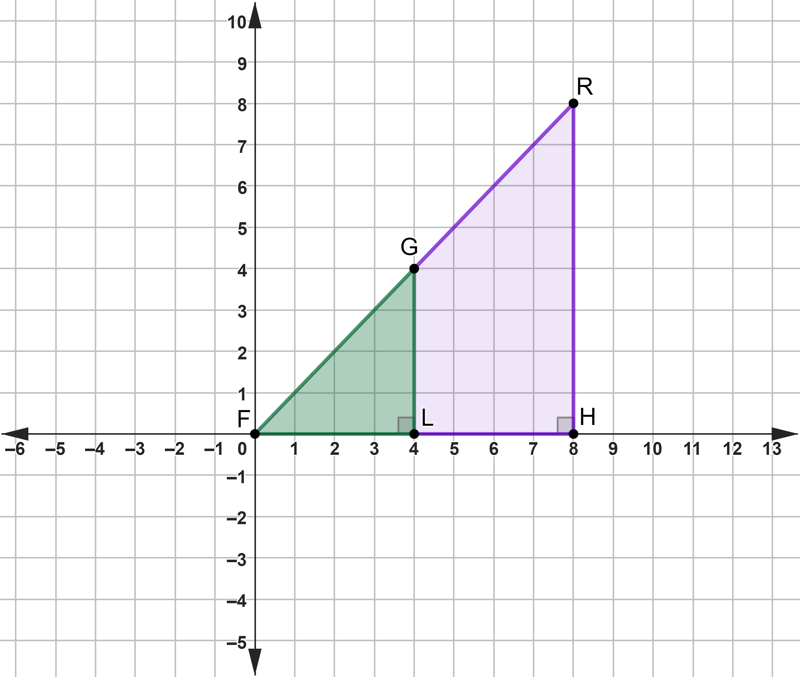

$∆FLG$ and $∆FHR$ were moved on the coordinate grid so that $F$ is at the origin.
Work with your partner to determine whether or not the values of the trigonometric ratios will change because the triangle moved. Summarize your findings.
volume 1, pg. 391

Slide 18
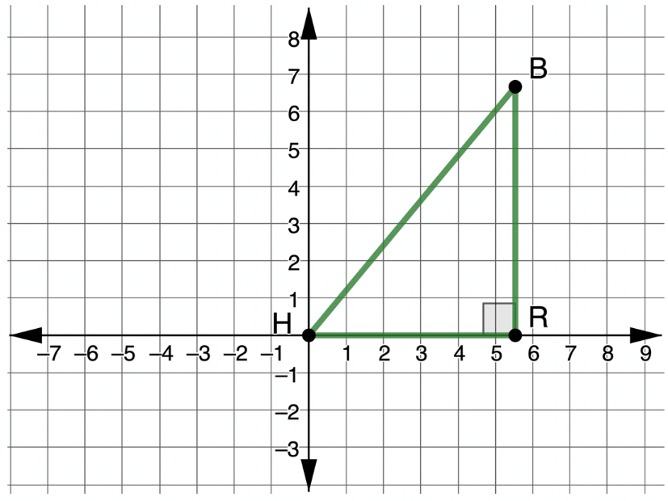

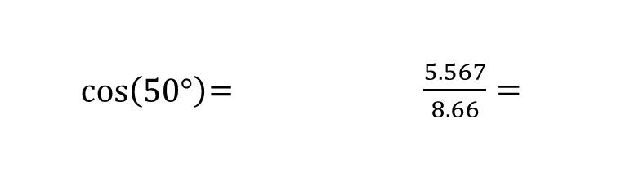

$∆HBR$ is shown on the coordinate grid, where $m∠HRB=90°$, $m∠RHB=50°$, $HR=5.567$, and $HB=8.66$.
Explain why the ratio $\cos\left(50°\right)≈\frac{5.567}{8.66}$ is true.
Find each value using a calculator. Round to the nearest thousandth.
$\cos\left(50°\right)$= | $\frac{5.567}{8.66}=$
volume 1, pg. 391

Slide 19
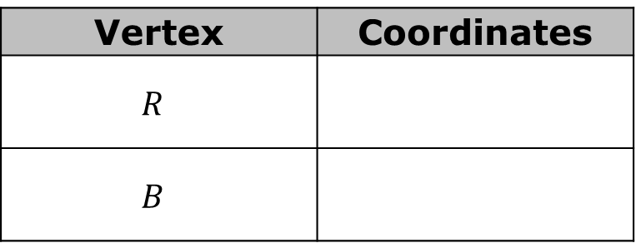
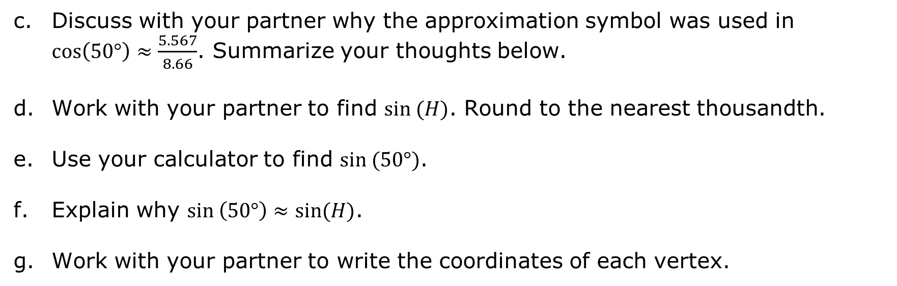
Discuss with your partner why the approximation symbol was used in $\cos\left(50°\right)≈\frac{5.567}{8.66}$. Summarize your thoughts below.
Work with your partner to find $sin (H)$. Round to the nearest thousandth.
Use your calculator to find $sin (50°)$.
Explain why $sin \left(50°\right)≈sin(H)$.
Work with your partner to write the coordinates of each vertex.
Vertex | Coordinates
$$R$$
$$B$$
volume 1, pg. 392

Slide 20

Guided Practice
volume 1, pg. 392

Slide 21

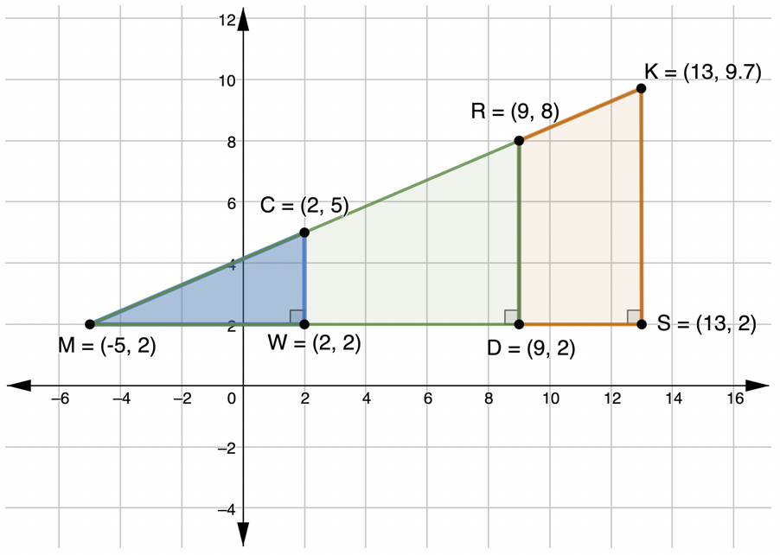

7.4.4 Guided Practice: Trigonometric Ratios and Similar Triangles
$∆CMW$, $∆RMD$, and $∆KMS$ are shown on the coordinate grid.
$∆CMW$, $∆RMD$, and $∆KMS$ are shown on the coordinate grid.
volume 1, pg. 392

Slide 22
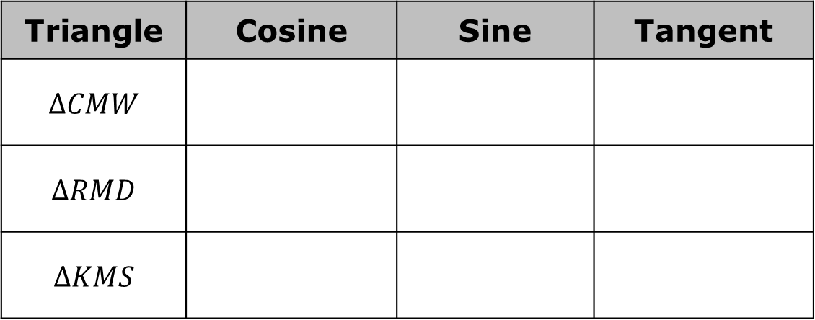

Using $∠M$ as the reference angle, find the three ratios for each triangle. Write the values as a decimal rounded to the nearest thousandth.
Yasmeen said she only found the ratios for $∆CMW$ then applied them to the other triangles. Explain using mathematics why she can do that.
Triangle | Cosine | Sine | Tangent
$$∆CMW$$
$$∆RMD$$
$$∆KMS$$
volume 1, pg. 392

Slide 23

Wrap-Up
volume 1, pg. 393

Slide 24
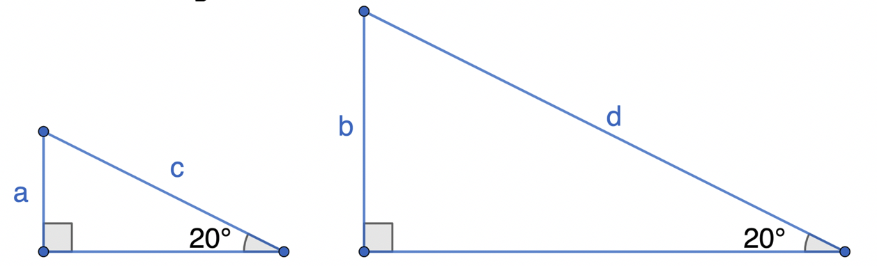

7.4.5 Wrap-Up: Ticket Out the Door
Two triangles are shown.
Describe how the ratios $\frac{a}{c}$ and $\frac{b}{d}$ are related.
What mathematical relationship(s) did you use to complete your description?
volume 1, pg. 393

